Slide 1


Slide 2
What is CloudHour?
Objective of CloudHour
Round-table discussion
Focus on a few key topics
Why It's Important
Rapid changes in cloud security and tech
Stay updated and connected for growth as community
How it will benefit the community
Real-time engagement with hosts and community members
Ask open questions and speak your opinion
Opportunity to affect the next agenda
Notes:
Objective of CloudHour
The objective of CloudHour is to create a collaborative space where professionals can come together to discuss, learn, and share insights on the most pressing topics in cloud security and modern workplace technology.
Why its important
CloudHour is important because, in the rapidly evolving landscape of cloud security and workplace technologies, staying updated and connected is crucial for career growth and organizational resilience
How it will benefit the community
By attending CloudHour, community members will have the unique opportunity to engage with industry experts in real-time, ask questions, network with like-minded professionals, and even have the chance to contribute their own expertise by becoming guest speakers in future episodes.

Slide 3

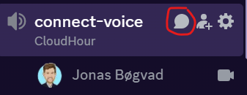
If you prefer to not talk or be asked questions press mute
press mute just mute the mic
If you preferer to chat press

Slide 4
Agenda
News/change sharing without going to deep into the topics.
Device query
Workload Identity
M365 E5 Security for SMB
Community Tools
Speakers we would like to see on the server

Slide 5
Device Query
Requires a license with Intune Advanced Analytics
Currently supports devices running Windows 10 and later. ​
Utilizes Kusto Query Language (KQL) to perform real-time queries on device properties
Offers integration with Copilot in Intune (public preview) to generate KQL queries using natural language requests
Enables administrators to perform actions such as Autopilot reset, BitLocker key rotation, and collecting diagnostics remotely based on query results.
Any experience?
Notes:
https://learn.microsoft.com/en-us/mem/analytics/device-query

Slide 6
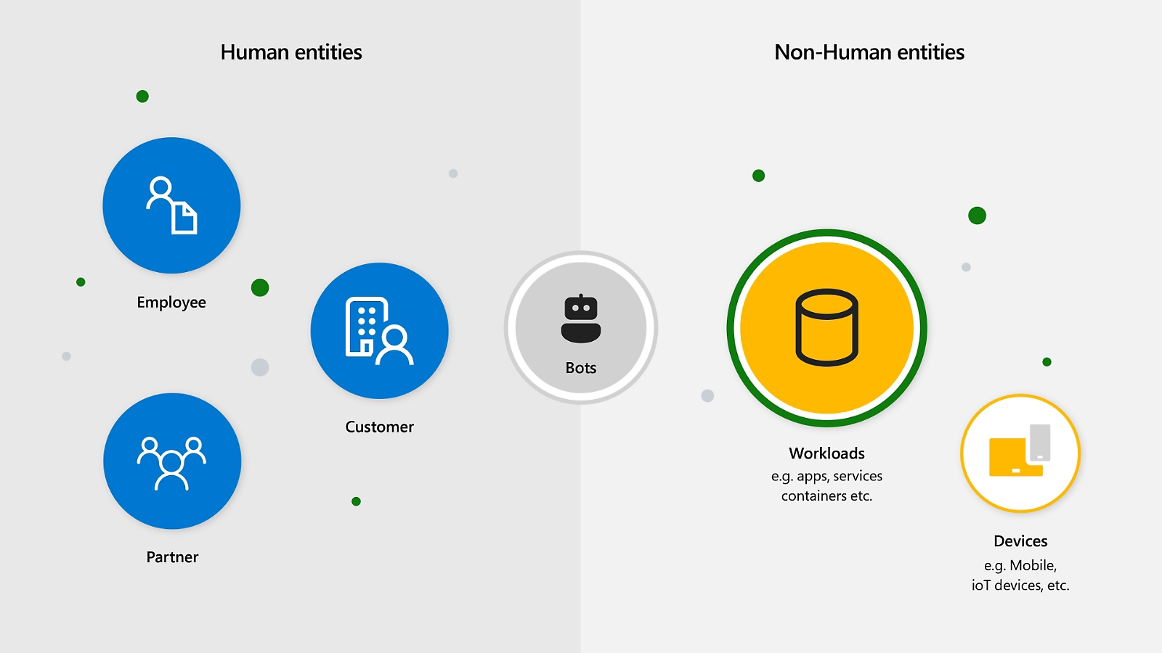
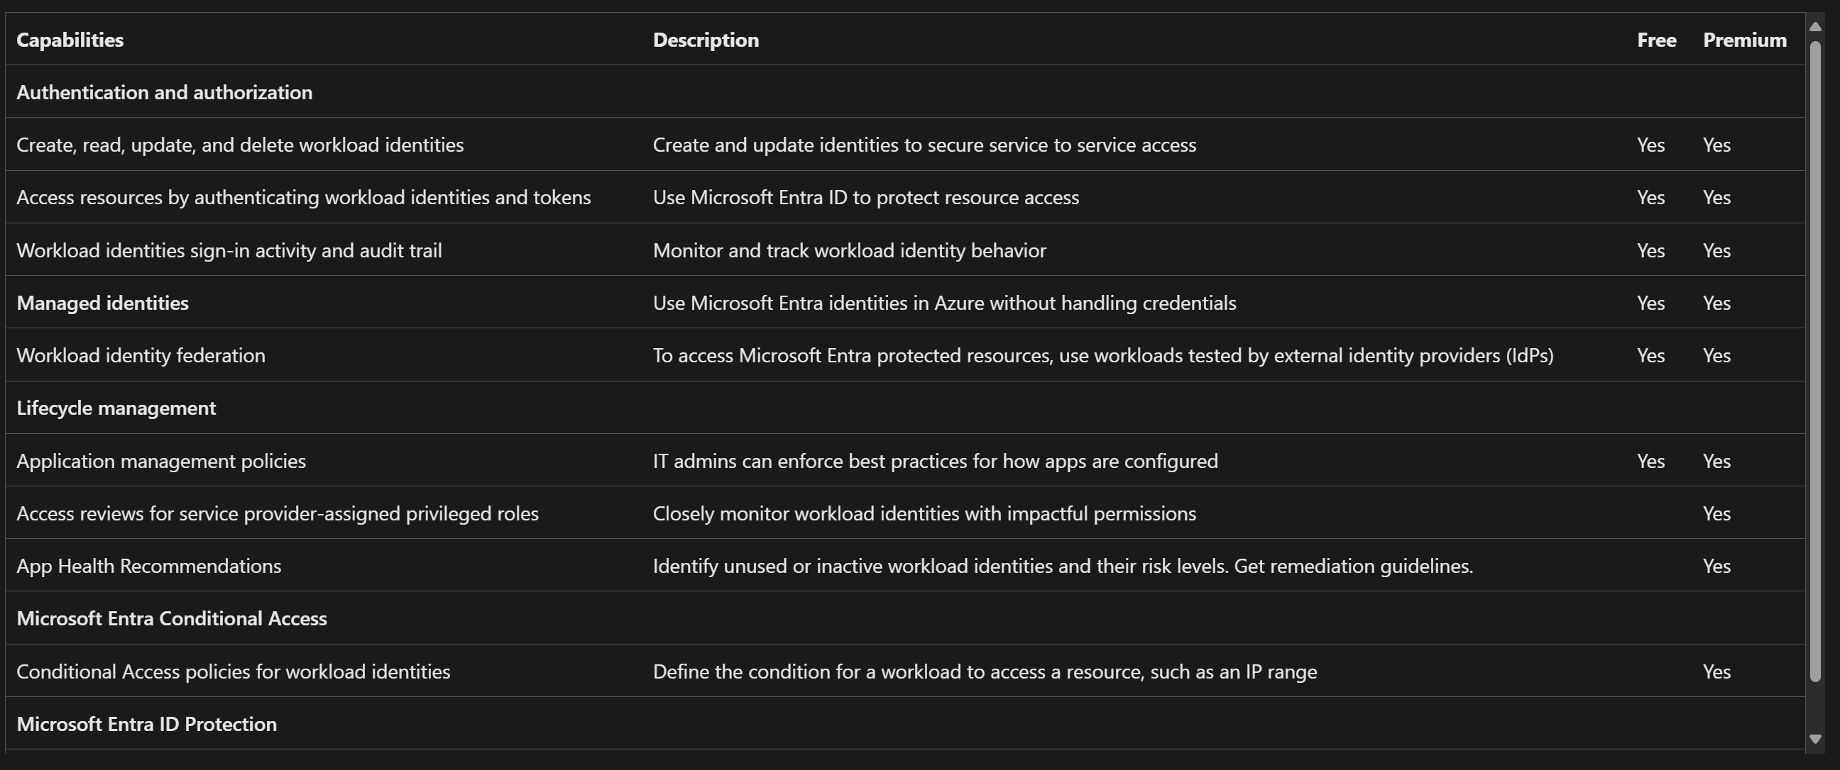
Workload ID Premium
$3/workload identity/month
30 days trial
Workload identity
General concept, commonly used in federated scenarios, like AKS or GitHub connecting to Azure
Notes:
https://devblogs.microsoft.com/identity/access-cloud-resources-across-tenants-without-secrets/
https://learn.microsoft.com/en-us/entra/workload-id/workload-identities-faqs

Slide 7
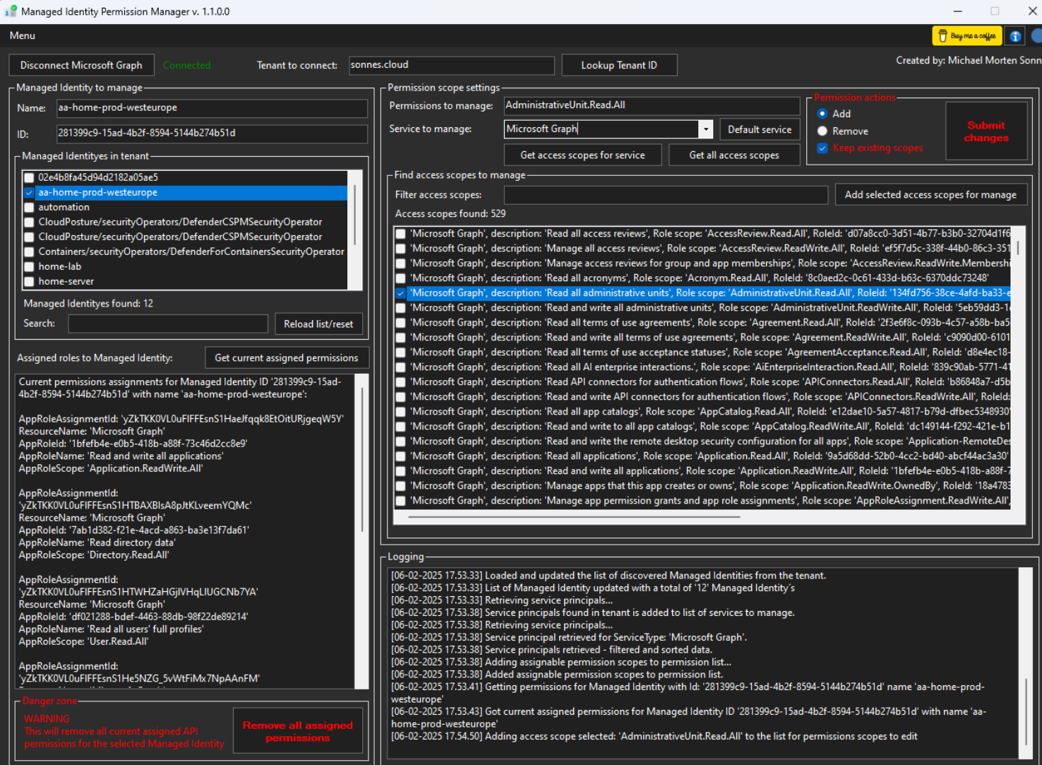
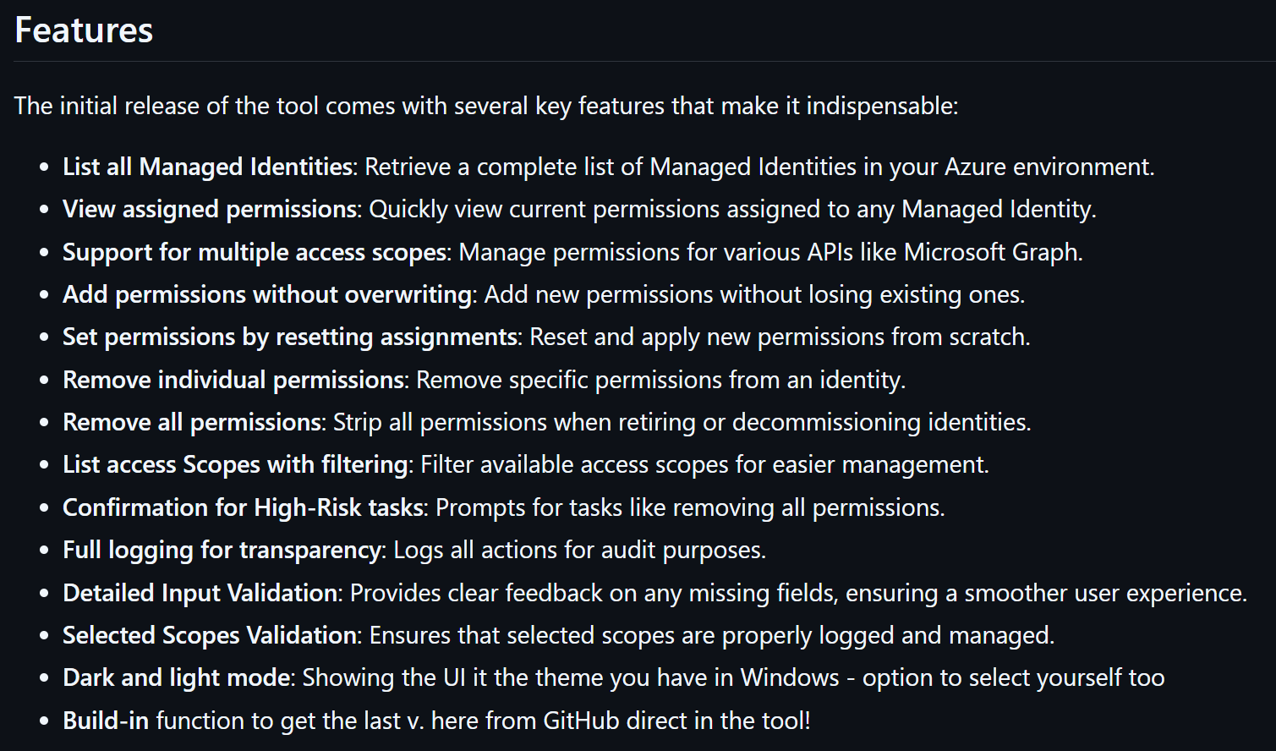
Entra ID Managed Identity Permission Manager
Made by Michael Morten Sonne [MVP]
Community driven
Great house keeping tool for Managed identity
Azure-specific solution, easy-to-use built-in identity provided by Azure to securely access Azure resources without manually managing credentials
Notes:
https://github.com/michaelmsonne/ManagedIdentityPermissionManager

Slide 8
Community Tools
Entra Authentication methods report by Daniel Bradley
ATA Intune Device Checker Tool Release Update Version 1.1 by Ali Koç
Monkey365
Notes:
https://ourcloudnetwork.com/create-a-free-interactive-entra-authentication-methods-report/
https://medium.com/@m365alikoc/ata-intune-device-checker-tool-release-update-version-1-1-a0fba2bfc25f / https://github.com/MSalikoc/ATA_Intune_Device_Checker_v1.1/tree/main
https://github.com/silverhack/monkey365

Slide 9
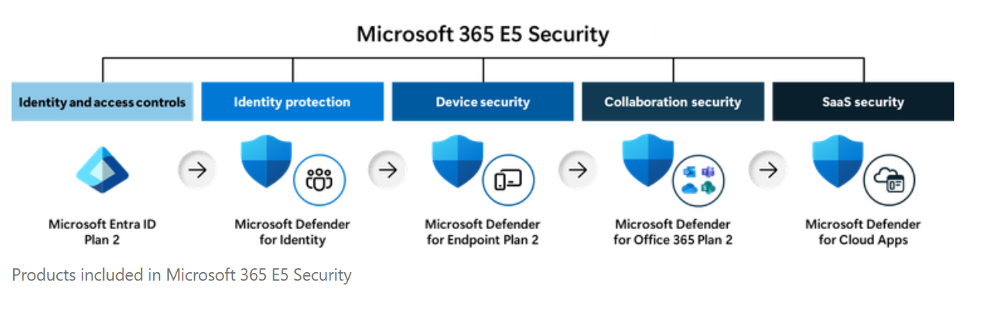
Microsoft 365 E5 Security is now available as an add-on to Microsoft 365 Business Premium
Notes:
https://techcommunity.microsoft.com/blog/microsoft365businessblog/microsoft-365-e5-security-is-now-available-as-an-add-on-to-microsoft-365-busines/438843
https://www.microsoft.com/en-us/security/small-medium-business
https://techcommunity.microsoft.com/discussions/anzmodernworkcommunity/introducing-the-smb-assessment-desk/3976765

Slide 10
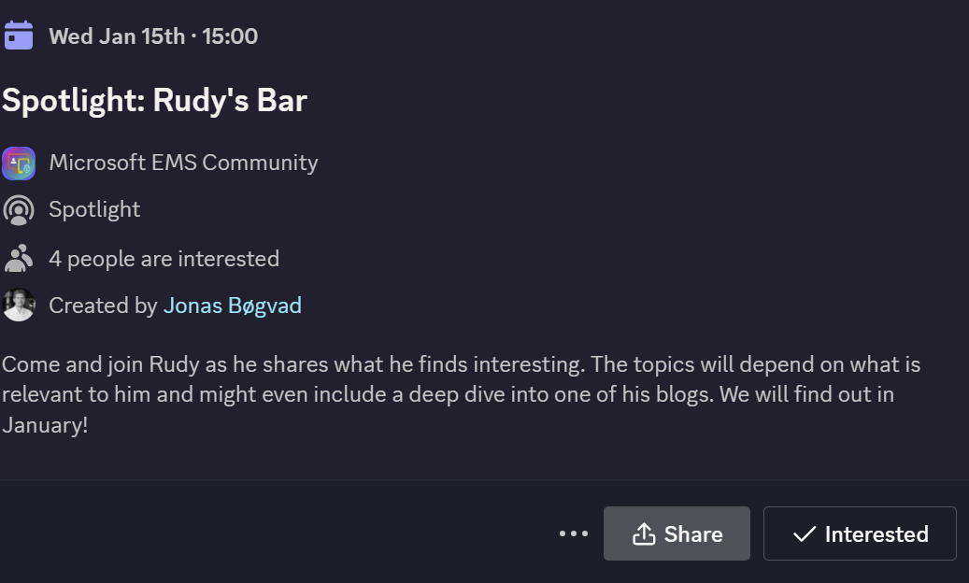
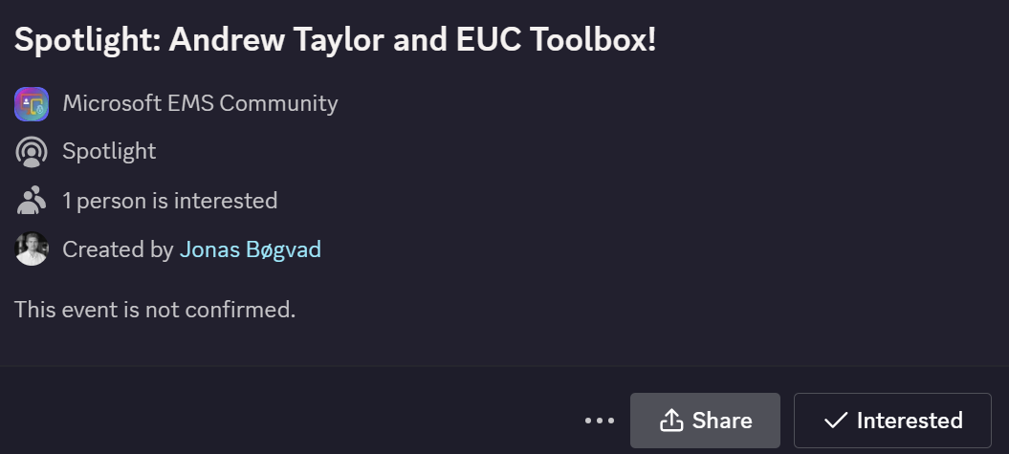
Spotlights sessions
OSD Cloud​
IntuneCD​ (awaiting confirmation on date)
Rudy Webinar ​
Johan Arwidmark ​
Purav (In contact)
Kelvin from CIPP ​
Andrew Taylor and EUC Toolbox (Confirmed)
TUGI tool (Confirmed)
Somesh Pathek (Confirmed)
WinTuner Stephan van Rooji (In contact)
IntuneCD Tobias (In contact)

Slide 11
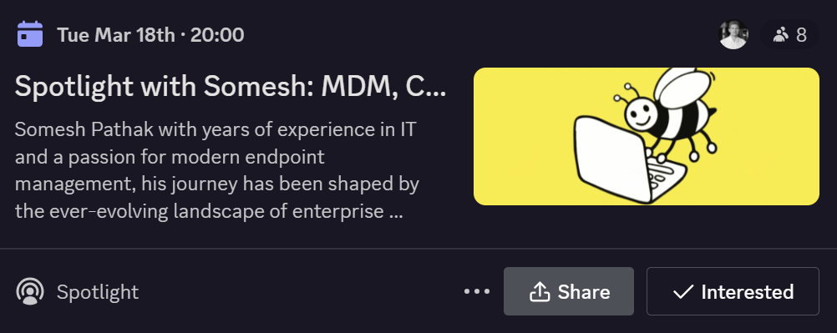
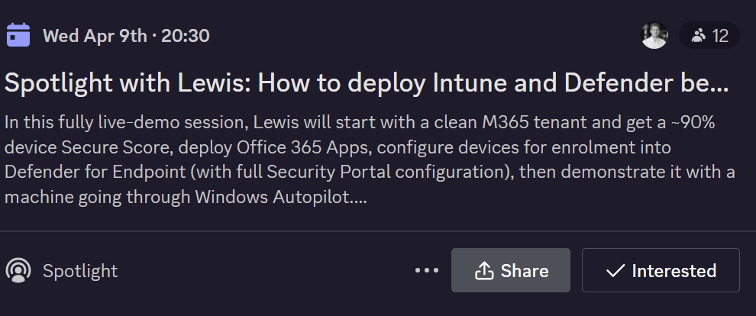
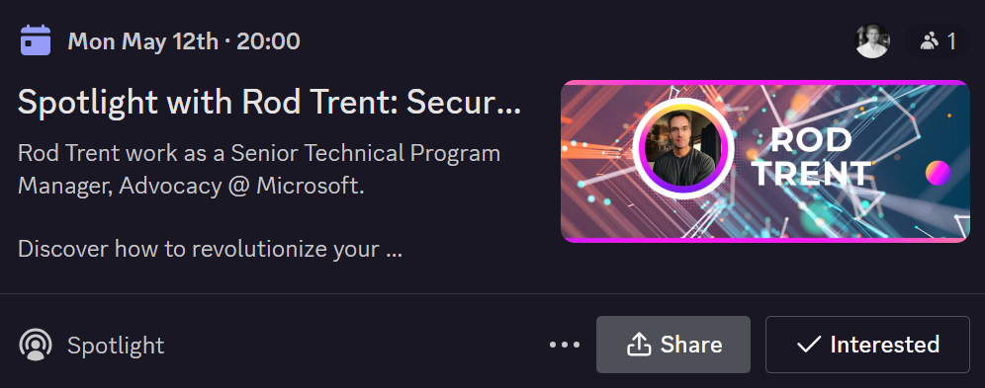
Upcoming spotlight events!
Somesh Pathak: MDM, Coffee, and Chaos: A Tech Story (Mar 18th)
Lewis Berry: How to deploy Intune and Defender better than 95% of the world: Live (April 9th)
Rod Trent: Securing the Future: Integrating Microsoft Security Copilot with Microsoft (May 12th)

Slide 12
How do you think the spotlights are going?
Any feedback?
Who would you wish could stop by the server?

